Slide 1

DEPARTMENT OF ARTIFICIAL INTELLIGENCE AND DATA SCIENCE ACADEMIC YEAR 2025 - 2026 SEMESTER III ARTIFICIAL INTELLIGENCE LABORATORY MINI PROJECT REVIEW HEART DISEASE PREDICTION USING ENSEMBLE LEARNING
REGISTER NUMBER | 2117240070028
NAME | ASHWITHA R
YEAR | ll
SECTION | A
FACULTY IN-CHARGE | Mrs. M. Divya

Slide 2
PROBLEM STATEMENT
Heart disease diagnosis is a complex process that involves analyzing multiple clinical parameters such as cholesterol levels, blood pressure, and electrocardiogram (ECG) results.
Traditional diagnostic methods often rely on individual measurements or physician expertise, which may not effectively capture the complex, non-linear relationships between these risk factors. This can lead to inaccurate predictions, delayed diagnosis, or misclassification of patients.
Therefore, there is a need to develop an efficient and reliable system that can analyze multiple medical attributes simultaneously and provide accurate predictions of heart disease. The challenge is to design a machine learning model that reduces prediction errors—especially false negatives—while maintaining high accuracy and interpretability.
This project aims to address this problem by implementing an ensemble learning-based approach that combines multiple classifiers to improve prediction performance and support better clinical decision-making.

Slide 3
IMPLEMENTATION AND CODE
Link to code in Git-hub Repository
List | Git-hub Repository Links
Implementation of Code Link | https://github.com/ASHWITHA2202/ASHWITHA-R_70028_ML/blob/main/cardiguard-ai_-ensemble-heart-disease-predictor.zip
Word Document Report Link | https://github.com/ASHWITHA2202/ASHWITHA-R_70028_ML/blob/main/HEART%20DISEASE%20PREDICTION%20_ML_MINIPROJECT.docx
PPT Link

Slide 4
THEORETICAL BACKGROUND
1. Heart Disease Prediction (Classification Problem) Heart disease prediction is a binary classification problem where the output is either presence (1) or absence (0) of disease. It uses patient data like age, cholesterol, blood pressure, and ECG results. The challenge is handling complex relationships between these features.
2. Machine Learning Algorithms Used This project uses algorithms like Decision Tree and Logistic Regression. Decision Tree works on rule-based splitting of data, while Logistic Regression predicts probability using a mathematical function. Each model captures different patterns in the data.
3. Ensemble Learning Approach Ensemble learning combines multiple models to improve accuracy and reliability. A Voting Classifier is used to aggregate predictions from different models. This reduces errors, especially false negatives, and provides better overall performance.
4. Advantages of Ensemble Method It improves prediction accuracy compared to single models. It reduces overfitting and handles complex data effectively. It also provides more stable and reliable results for medical diagnosis

Slide 5
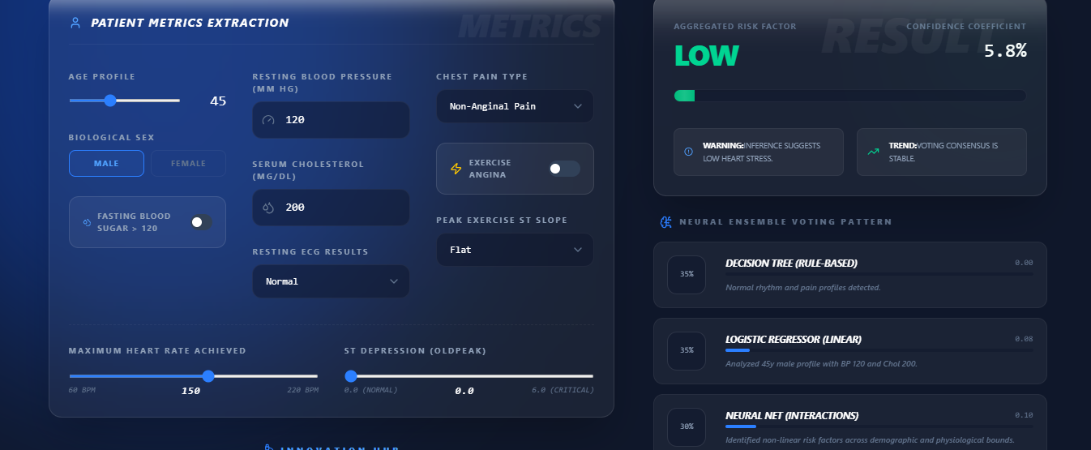
OUTPUT AND RESULTS

Slide 6
OUTPUT AND RESULTS
1. System Output The system takes patient medical data such as age, blood pressure, cholesterol, and ECG values as input. It processes this data using multiple machine learning models combined through ensemble learning. The final output shows whether heart disease is present along with a confidence level.
2. Model Performance The ensemble model achieved an accuracy of around 85%–90%, showing strong prediction capability. It also provided good precision, recall, and F1 score values. These results indicate that the model performs reliably in identifying heart disease cases.
3. Overall Result Compared to individual models, the ensemble approach improved accuracy and reduced prediction errors. It especially minimized false negatives, which is important in medical diagnosis. Overall, the system provides stable and effective predictions for heart disease detection

Slide 7
REFERENCES
UCI Machine Learning Repository, Heart Disease Dataset. Available at: https://archive.ics.uci.edu/ml/datasets/heart+Disease
Aurélien Géron, Hands-On Machine Learning with Scikit-Learn, Keras, and TensorFlow, 2nd Edition, O’Reilly Media, 2019.
Tom M. Mitchell, Machine Learning, McGraw-Hill Education, 1997.
Scikit-learn Documentation, Machine Learning in Python. Available at: https://scikit-learn.org/stable/
Kaggle, Heart Disease Prediction Dataset and Notebooks. Available at: https://www.kaggle.com/datasets/redwankarimsony/heart-disease-data
Ian H. Witten, Eibe Frank, Mark A. Hall, Data Mining: Practical Machine Learning Tools and Techniques, 3rd Edition, Morgan Kaufmann, 2011.

